Slide 1
SE-3002 Software quality engineering
Part II-Software Testing
Functional Testing
Lecture # 16, 17, 18

Slide 2
Today’s Outline
Cause Effect Testing
Pairwise Testing

Slide 3
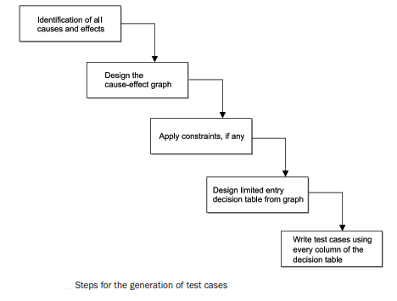
CAUSE-EFFECT GRAPHING TECHNIQUE
Popular technique for small programs and considers the combinations of various inputs.
Two terms: Causes and Effects, which are nothing but inputs and outputs respectively.
A list is prepared for all causes and effects.

Slide 4
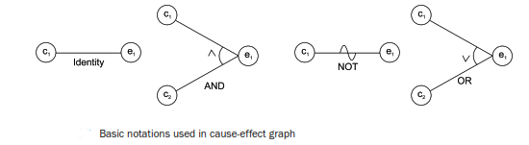

Design of Cause-Effect Graph
Each node represents either true or false state and may be assigned 1 and 0 value respectively.

Slide 5
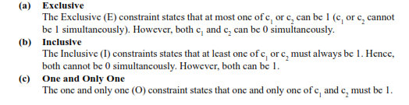
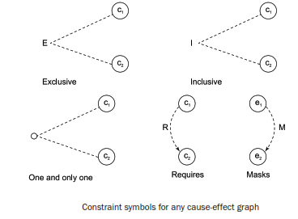

Use of Constraints in Cause-Effect Graph

Slide 6
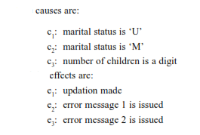
Example
Consider the example of keeping the record of marital status and number of children of a citizen. The value of marital status must be ‘U’ or ‘M’. The value of the number of children must be digit or null in case a citizen is unmarried. If the information entered by the user is correct then an update is made. If the value of marital status of the citizen is incorrect, then the error message 1 is issued. Similarly, if the value of number of children is incorrect, then the error message 2 is issued.

Slide 7
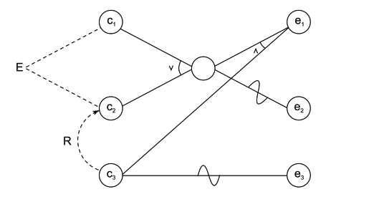
solution

Slide 8
Draw the cause-effect graph and generate test cases
A tourist of age greater than 21 years and having a clean driving record is supplied a rental car. A premium amount is also charged if the tourist is on business, otherwise it is not charged. If the tourist is less than 21 year old, or does not have a clean driving record, the system will display the following message: “Car cannot be supplied”.

Slide 9
Solution:
The causes are c1 : Age is over 21
c2 : Driving record is clean
c3 : Tourist is on business
effects are e1 : Supply a rental car without premium charge.
e2 : Supply a rental car with premium charge
e3 : Car cannot be supplied

Slide 10
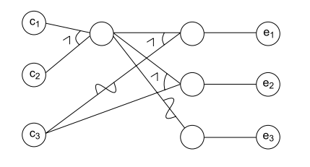

Slide 11
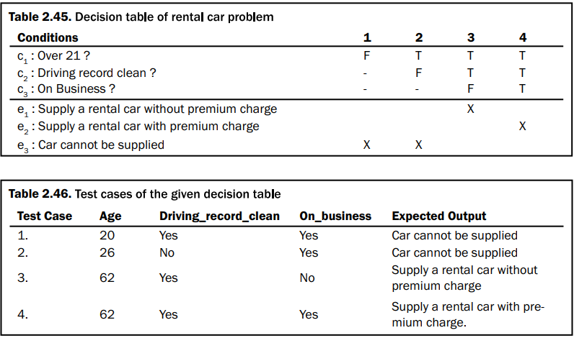

Slide 12
applicability
Cause-effect graphing considers dependency of inputs using some constraints.
Effective only for small programs because, as the size of the program increases, the number of causes and effects also increases and thus complexity of the cause-effect graph increases.
For large-sized programs, a tool may help us to design the cause-effect graph with the minimum possible complexity.
Limited applications in unit testing and hardly any application in integration testing and system testing.

Slide 13
Pair-wise testing
Pairwise Testing is a test design technique that delivers hundred percent test coverage.
A black-box test design technique in which test cases are designed to execute all possible discrete combinations of each pair of input parameters.
Techniques like boundary value analysis and equivalence partitioning can be useful to identify the possible values for individual factors. But it is impractical to test all possible combinations of values for all those factors. So instead a subset of combinations is generated to satisfy all factors.
All-Pairs technique is very helpful for designing tests for applications involving multiple parameters. Tests are designed such that for each pair of input parameters to a system, there are all possible discrete combinations of those parameters. The test suite covers all combinations; therefore it is not exhaustive yet very effective in finding bugs

Slide 14
Pairwise Testing Example Car Ordering Application:
The car ordering application allows for Buying and Selling cars. It should support trading in Delhi and Mumbai.
The application should have registration numbers, may be valid or invalid. It should allow the trade of following cars: BMW, Audi, and Mercedes.
Two types of booking can be done: E-booking and In Store.
Orders can be placed only during trading hours.

Slide 15
Step #1: Let’s list down the variables involved.
1) Order category a. Buy b. Sell
2) Location a. Delhi b. Mumbai
3) Car brand a. BMW b. Audi c. Mercedes
4) Registration numbers a. Valid (5000) b. Invalid
5) Order type a. E-Booking b. In-store
6) Order time a. Working hours b. Non-working hours

Slide 16
Reference: https://www.softwaretestinghelp.com/what-is-pairwise-testing/
If we want to test all possible valid combinations: = 2 X 2 X 3 X 5000 X 2 X 2 = 240000 Valid test cases combinations :(
There is also an infinite number of invalid combinations.
Step #2: Let’s simplify
– Use a smart representative sample. – Use groups and boundaries, even when data is non-discrete. – Reduce Registration Number to Two
Valid registration number
Invalid registration number
Now let’s calculate the number of possible combinations = 2 X 2 X 3 X 2 X 2 X 2 = 96

Slide 17

Step #3: Arranging variables and values involved.
When we arrange variables and values involved, it looks something like this.

Slide 18
Now order the variables so that the one with the most number of values is first and the least is last.

Slide 19
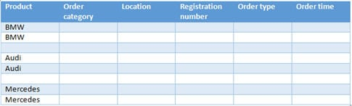
Step #4: Arrange variables to create a test suite
Let’s start filling in the table column by column. Initially, the table should look something like this. The three values of Product (variable having the highest number of values) should be written two times each (two is the number of values of next highest variable i.e. Order category).

Slide 20
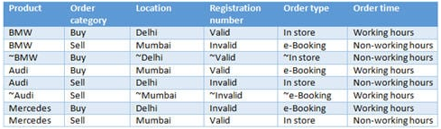
Solution:

Slide 21
Practice Problem:
Toronto public library offers books for reading which could be reserved and taken to home whereas some books can never be reserved based on its barcode but available for reading only in-store.
Toronto public library is only for residents of Toronto. Other cities residents can only read the books but cannot reserve a book and take home.
Books can be reserved online through website (online) and pick up at the library or directly in-house at the library.
Books are available in two languages i.e. French and English.
Books are available for categories as encyclopedia, fiction, and academics

Slide 22
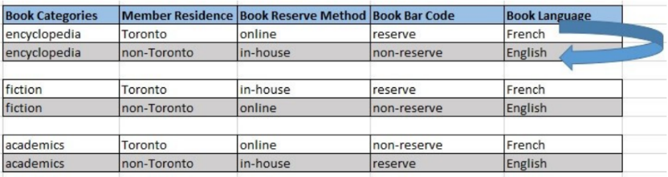
Solution:

Slide 23
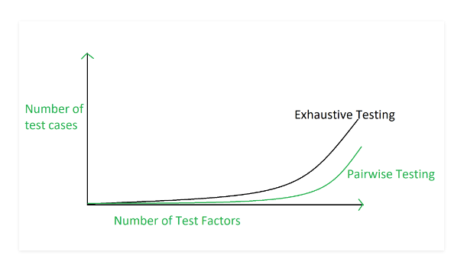
Graphical Representation of Pairwise Testing

Slide 24
Advantages & Disadvantages of Pairwise Testing
Pairwise testing is not beneficial if the values of the variables are inappropriate.
In pairwise testing it is possible to miss the highly probable combination while selecting the test data.
In pairwise testing, defect yield ratio may be reduced if a combination is missed.
Pairwise testing is not useful if combinations of variables are not understood correctly.
Pairwise testing reduces the number of execution of test cases.
Pairwise testing increases the test coverage almost up to hundred percentage.
Pairwise testing increases the defect detection ratio.
Pairwise testing takes less time to complete the execution of the test suite.
Pairwise testing reduces the overall testing budget for a project.

Slide 25

That is all

